Slide 1
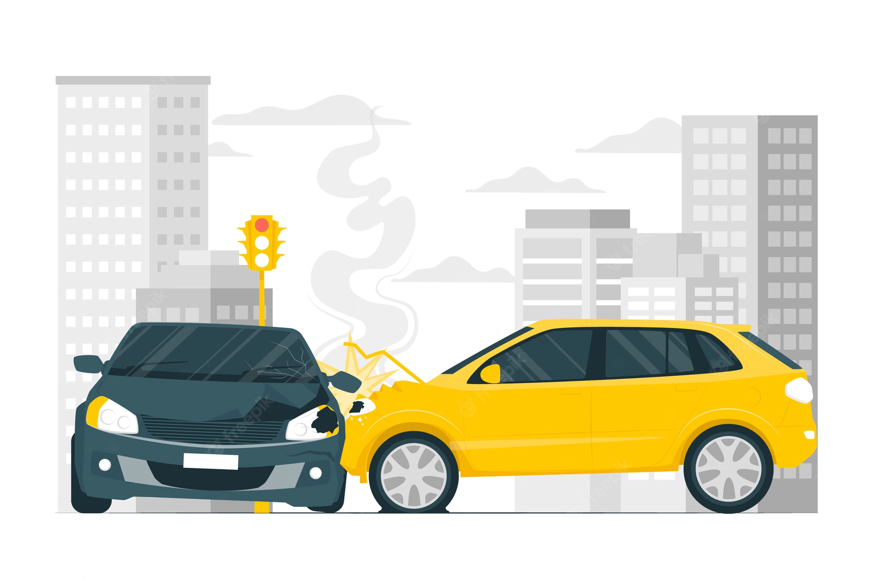
Vehicle Insurance Claim Fraud Detection
G03_FDM

Slide 2
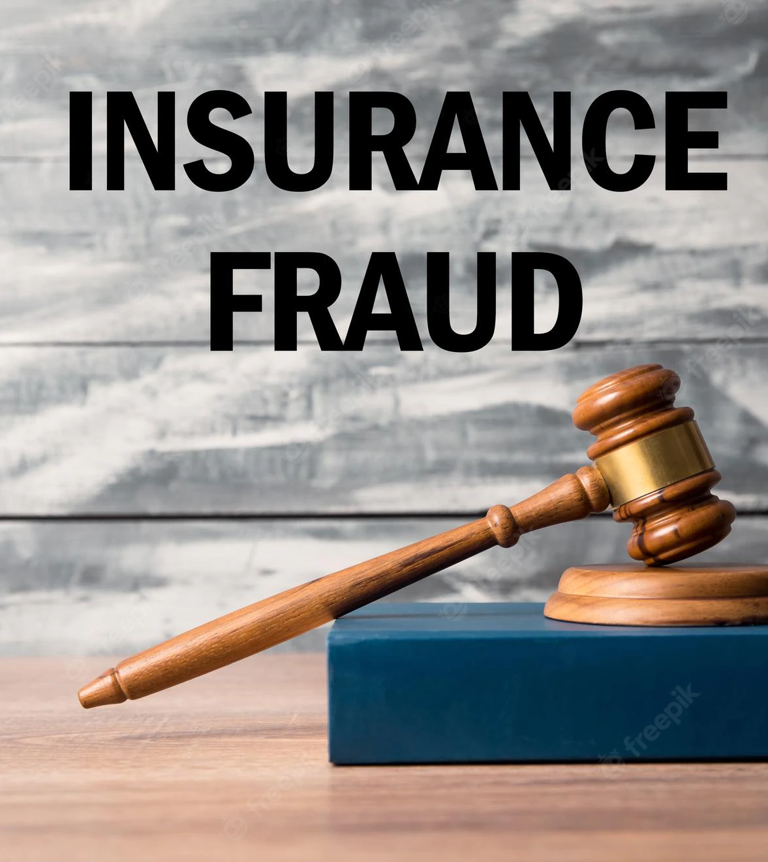
Introduction
Background of the Dataset
The purpose of doing this project is to find a real-world problem and to find a technical solution for that by creating a model with the help of Data Science and Machine-Learning concepts.
The dataset we have chosen is related to vehicle insurance claim fraud detection and the dataset contains 15420 data points with 14497 non-fraudulent transactions and 923 fraudulent transactions happened in 1994 to 1996. Our goal is to build a model that can detect vehicle insurance fraud with the help of this dataset.

Slide 3
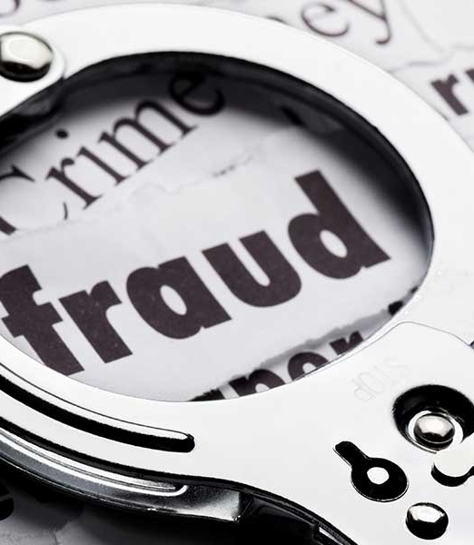
Identifying the Problem
Conspiring to create fraudulent or inflated claims about property damage or personal injuries because of an accident is known as vehicle insurance fraud. The use of phantom passengers, where individuals who were not even present at the accident scene claim to have suffered severe injuries, staged accidents, where fraudsters purposefully "arrange" for accidents to occur, and false personal injury claims, where personal injuries are grossly exaggerated are a few frequent examples. As frauds are unethical and are losses to the companies, we need a way to cut losses for the insurance company as less losses equates to more earnings.

Slide 4
Getting that as a business idea and we are providing solutions through machine learning
Identify the problem with business goals
The fraudulent claims are interconnected with false details which cannot be found by the claim provider easily. These fraudsters arrange these accidents to occur, and they use phantom passengers who were not even at the scene.
So, to predict these fraudsters we have planned to evolve machine learning which will be an easy and pretty accuracy process.

Slide 5
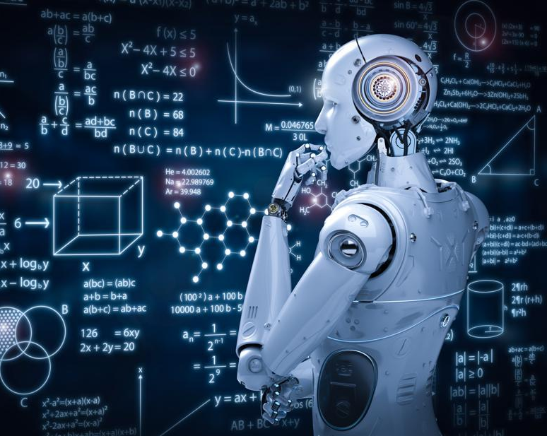
Solutions through Machine Learning
We have planned to build a classification model to solve this problem. The goal of classification is to utilize input training data for the purpose of predicting the likelihood or probability that the data that follows will fall into one of the predetermined categories.
Claim fraud varies on Base policy, address change, age of policy holder, driver rating, vehicle price, etc. Through the model which we are designing it can simply enter the details and predict that it is a fraud or not. So, when claim ensuring person enter the details he could come to a decision about fraudulent status.
First, we will be applying necessary pre-processing steps to dataset as mentioned in coming parts. After that model validation will be done. Next, we have planned to build the front-end part of this application where users can apply data to the model.

Slide 6
The processes through Machine Learning
After the data identification we started the process through Machine Learning to build our model.
Data Preprocessing
- Check for missing values
- Check for unique Values
- Check for duplicate Values
- Categorical Values convert into Numerical Values
Partitioning
- Before feeding the data into the model, the data has to split into training and testing sets.
Model Selection
- We had selected classification models.

Slide 7
Models we selected in classification
A classification algorithm is a function that weights the input features such that one class is divided into positive values and the other into negative values by the output.
In addition, the goal behind selecting the classification prediction is that it accurately predicts the target class for each case in the data.
We used Decision Tree Classification, Random Forest Classification, Naïve Bayes prediction technique for the “Vehicle Insurance Claim Fraud Detection” dataset.
For the above models are following the accuracy values,
Accuracy in Decision Tree Classification Model: 0.9274172
Accuracy in Random Forest Classification Model: 0.936688
Accuracy in Naïve Bayes Classification Model: 0.89456953
Therefore, we have selected Random Forest Classifier as our classification model to do the prediction because of its high accuracy than other models.

Slide 8
Explain deploying implementation.
Using python, the models are built and trained. As a pickle file(serialization),we have saved the trained model objects. We have built a flask environment with an API endpoint that would encapsulate our trained models and allow them to receive inputs (features) via HTTP / HTPPS POST requests and then return the measured output after the previous serialized models have been serialized.
Via a REST API using Flask, the model is made available to the user. Flask is a micro framework focused on pythons used for designing small-scale websites.
Link :- https://frauddetection-api-1001.herokuapp.com/

Slide 9

THANK YOU

